Slide 1
Amazon Coding Challenge Bright Network Internship
Files and Output

Slide 2
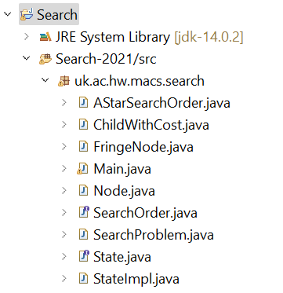
SOURCE FILES

Slide 3
Files description
SearchOrder- Encodes a search order by describing how nodes are added to the fringe. Note that nodes are always removed from the front of the fringe.
AStarSearchOrder- Class that contains methods to add nodes to a fringe during A* Search. The states are expanded in the increasing order of the total cost. No state can be expanded more than once and when inserting nodes to the fringe, ties are resolved so that states with the lowest state value are ordered first.
ChildWithCost- Represents a connection in the state graph: a node, and the cost of getting from the parent to this node.
FringeNode- Represents a node on the frontier of the search space. Includes the actual node, the parent node (i.e., the node that was expanded to add this one), as well as the cost of getting to this node (the "g" value).

Slide 4
Files description
Node- Represents a single node in the search space: it has a value, as well as a set of child nodes with associated costs on the transitions.
State- Represents a state in the search space.
StateImpl- Class representing a state in the grid, implements the State interface
SearchProblem- Represents a search problem, by running the given search order on given search spaces.
Main- Class to represent the given grids and run the A* Search Algorithm on them

Slide 5
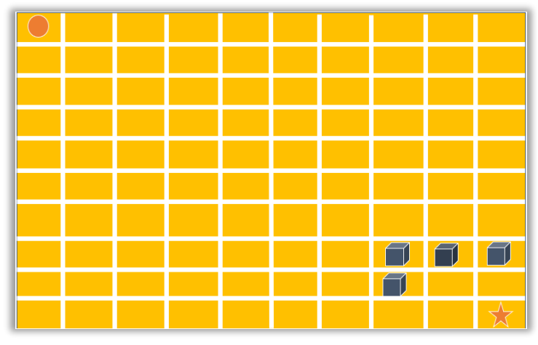
Phase-1 grid

Slide 6
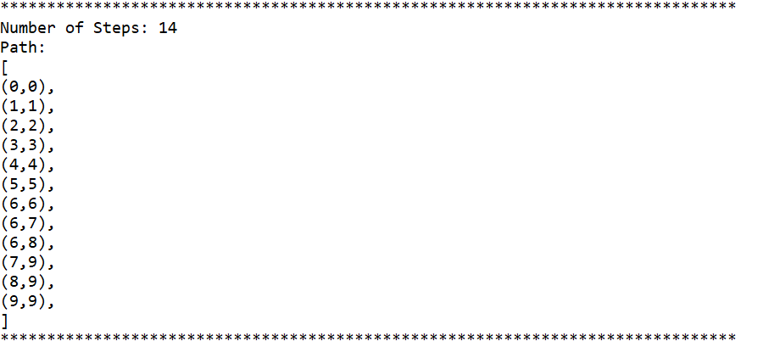
Output- Phase 1

Slide 7
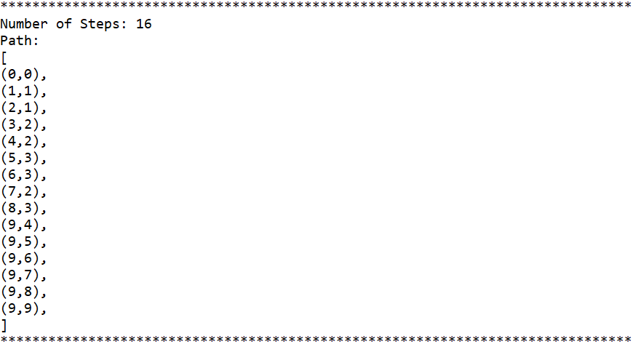
Output phase-2

Slide 8
For Any clarifications,
please contact shreyakala@ymail.com

